Slide 1

MAI Project Pitches
SS25 & WS25/26
Magda Gregorová — magda.gregorova@thws.de
Licensed according to CC-BY-SA 4.0

Slide 2
Study Organization
1st semester: Scientific Seminar 5 ECTS (week 12-16 May) Scientific skills:
planning academic projects
identifying and evaluating resources
academic/scientific writing
Evaluation:
participation in activities
project plan proposal
pass/fail
2nd semester: Project Module
10 ECTS (300 hrs ≈ 2 months full time) Project work:
group project (3 students)
independent, self-organized work
applied research
Evaluation:
contribution to project
project scientific paper (conference)
project demo (start-up)
Strategy recommendation: use scientific seminar to prepare for project module
choose project topic that you are interested in learn about topic, identify resources, plan project
form group, prepare project plan proposal & apply to supervisor
focus in courses and develop project-relevant skills
2 / 7

Slide 3

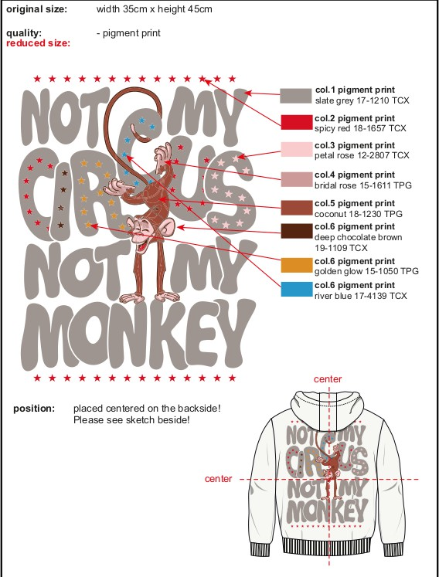
SVG generation for fashion print design
Aims:
Pipeline for generating SVG images
Start from text-prompt or raster image
Challenge:
Possibility to manipulate objects
Ability to generate text
Multimodal deep generative modeling
Expectations:
Comparative analysis of existing methods
Codebase with recommended pipiline
Refs:
arXiv:2306.06441, arXiv:2312.11334, arXiv:2501.03992, arXiv:2406.05404
Prof. Dr. Magda Gregorová
3 / 7

Slide 4

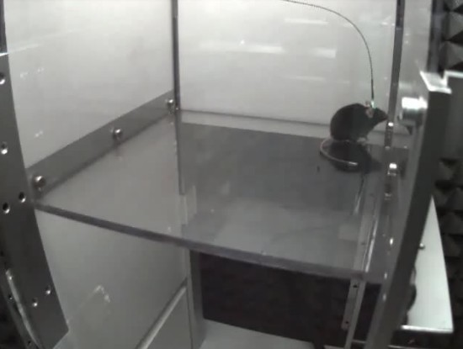
Tracking and 3D triangulation of moving mice
Aims:
Keypoints of moving mice without physical markers
Multi-camera 3D triangulation and trajectories
Challenge:
Keypoint consistency across views and frames
Camera calibration and synchronization
High-throughput processing pipeline (large data)
Expectations:
Codebase for detection and triangulation
3D trajectories for all videos
Refs:
DeepLabCut, Jarvis, https://doi.org/10.1038/s41592-018-0234-5
Prof. Dr. Magda Gregorová
4 / 7

Slide 5

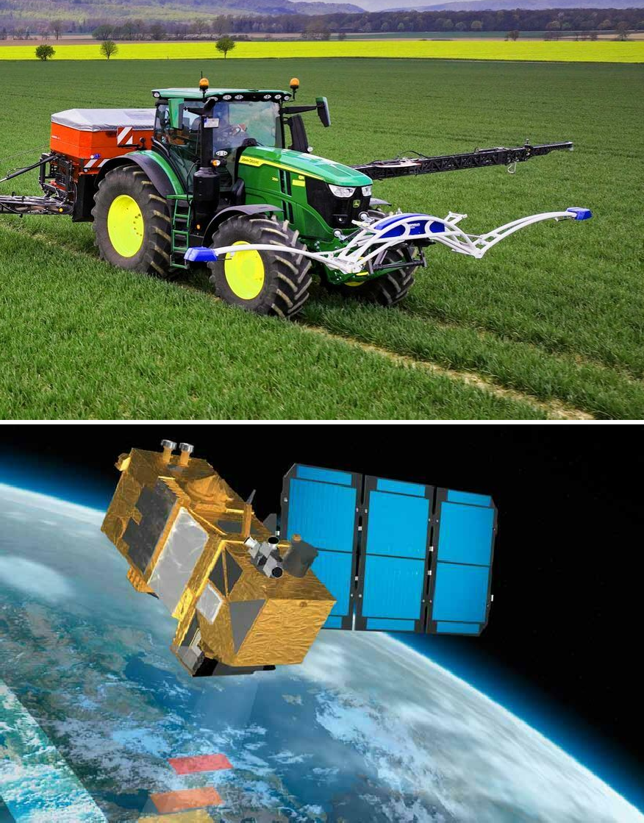
Satellite-based measurements of crop nitrogen status
Aims:
Predict crop nitrogen status from Sentinel-2 data
Produce maps of field nitrogen status and biomass
Challenge:
High (in-field) vs low (satellite) resolution
Temporal interpolation of field data
Multi-spectral spatio-temporal data (large, complex)
Expectations:
Identification of relevant spectral bands
Codebase for geo-processing and predictions
Refs:
TorchGeo, https://arxiv.org/abs/2207.08051,
https://github.com/satellite-image-deep-learning,
Prof. Dr. Magda Gregorová
5 / 7

Slide 6

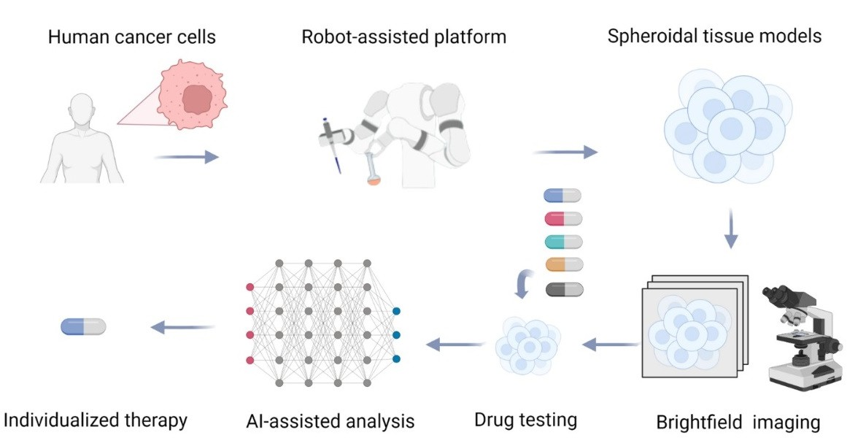
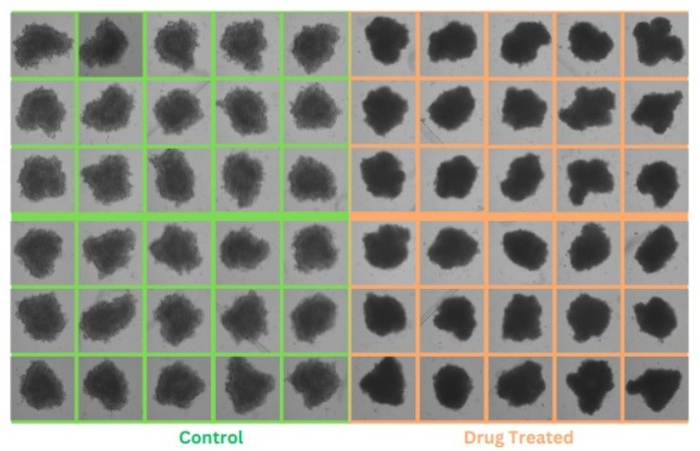
Drug efficacy on pancreatic tumor 3D spheroids
Aims:
Drug efficacy from bright-field microscopy images
Challenge:
Biology bright-field microscopy
Laboratory environment, noisy data
Labelling expensive - few labelled data
Unsupervised representation learning
Expectations:
Pipeline and codebase for drug efficacy prediction
Predictions for subset of data
Refs:
https://doi.org/10.1038/s41598-023-33271-3,
https://advanced.onlinelibrary.wiley.com/doi/full/10.1002/advs.202406608
Prof. Dr. Magda Gregorová
6 / 7

Slide 7

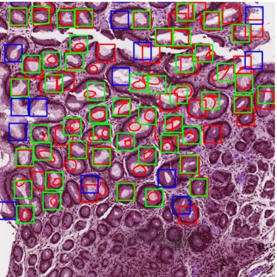
Detection of helicobacter pylori in gastric biopsy
Aims:
Speed up tissue histopathology
Identify suspicious regions for clinician
Challenge:
Biology, histopathology data
Large size (100k x 50k), low prevalence
Weak labelling with missing labels
Expectations:
Active learning approach for weak labeling
Pipeline and codebase for helicobacter detection
Refs:
10.1007/s10278-024-01021-0,
https://doi.org/10.1186/s12876-020-01494-7,
https://docs.ultralytics.com/models/yolo11/
Prof. Dr. Magda Gregorová
7 / 7

